Slide 1
SOCIAL ISSUES

Slide 2
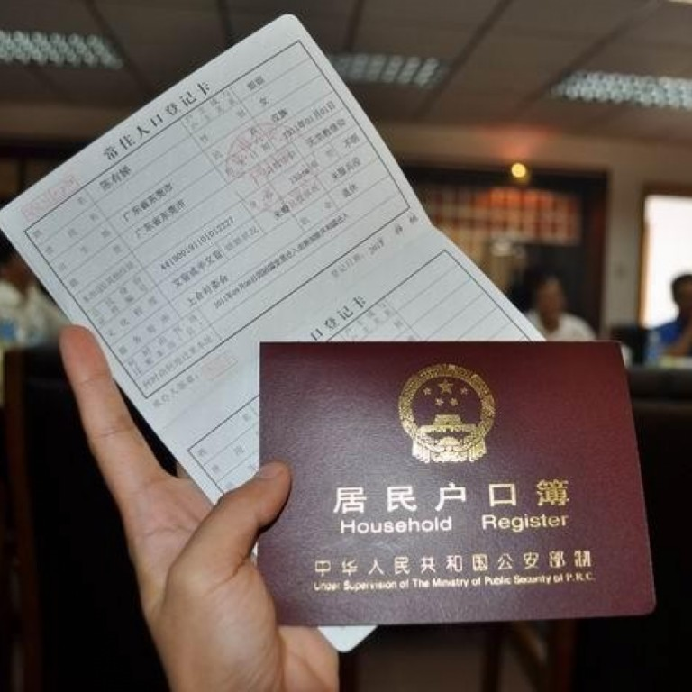
HU KOU
HOUSEHOLD REGISTRATION SYSTEM.
INTERNAL PASSPORT.
CANNOT MOVE TO HIGHER RANKED AREAS
REASON FOR INTRODUCTION.. (1958) REGULATION OF POPULATION DISTRIBUTION AND URBAN –RURAL MOVEMENT.
TOOL FOR SOCIAL CONTROL.

Slide 3
ILLEGAL MIGRANT.
APARTHEID OR CASTE SYSTEM BY ANOTHER NAME.
STATUS OF NONG MIN. GREAT LEAP FORWARD DISASTER.

Slide 4
QU DAGONG
RURAL – URBAN DIVIDE.
400 MILLION.
BREAKDOWN OF SOCIAL VALUES.
FACTORY GIRLS BY LESLIE CHANG.

Slide 5
GAO KAO(高考)
NATION WIDE COLLEGE ENTRANCE EXAM.
10 MILLION CANDIDATES. 7-8 JUNE EVERY YEAR.
LAST YEAR OF SENIOR HIGH SCHOOL. NO AGE RESTRICTION.
9 HOURS OF EXAMS. CHINESE AND MATHS COMMON.
ONE FOREIGN LANGUAGE (ENGLISH).
SOCIAL SCIENCES STREAM(HISTORY POLITICAL SCIENCE AND GEOGRAPHY)
OR NATURAL SCIENCES STREAM (PHYSICS, CHEMISTRY, BIOLOGY).. 90-95%.

Slide 6
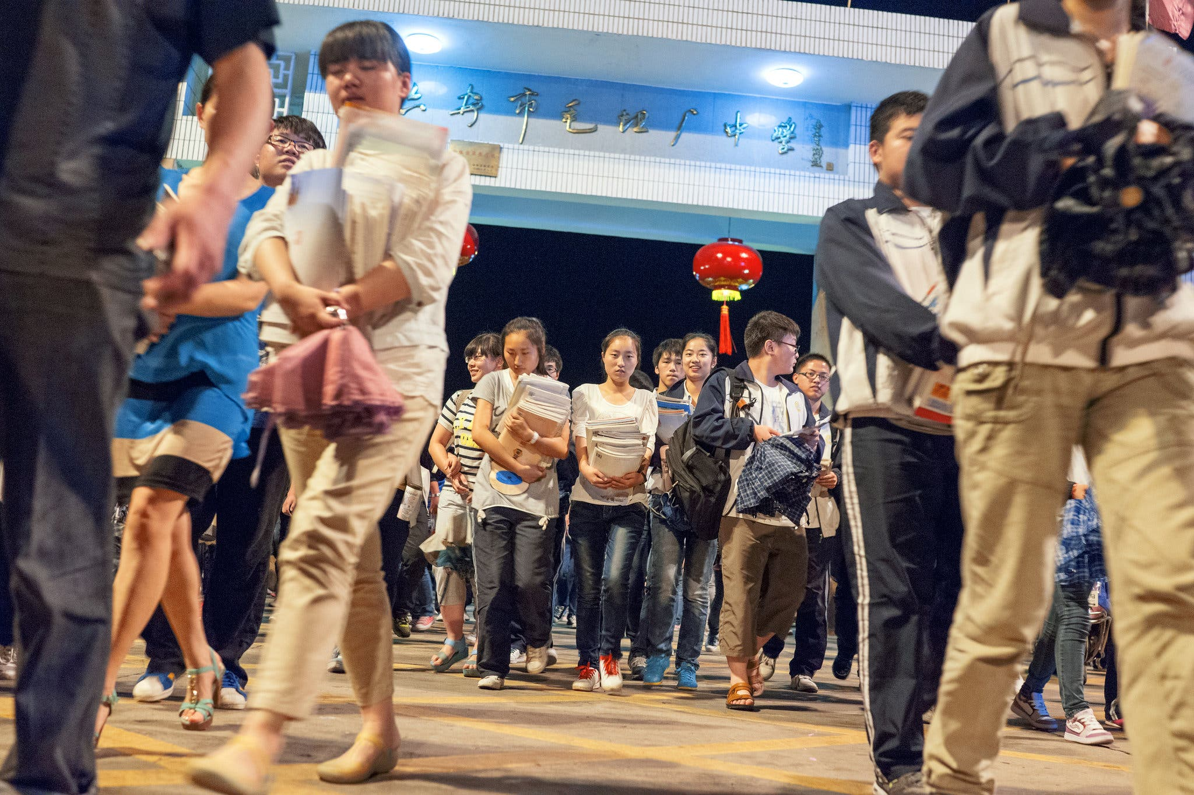
FLAWS? HOME WORK.
TERRIBLE COACHING CENTRES.(STUDY CITIES)

Slide 7
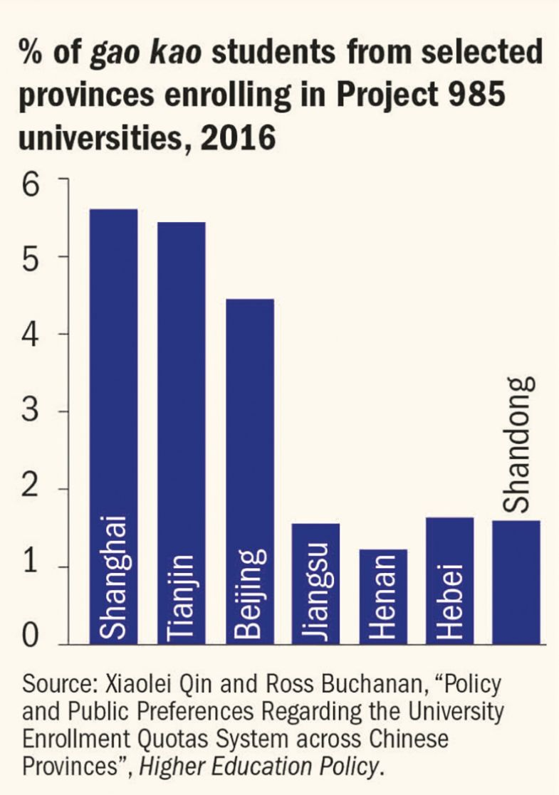
FIXED ADMISSION QUOTAS FOR EACH PROVINCE/ MUNICIPALITY. UNEQUAL.
ACCENTUATED IN ADMISSIONS TO PROJECT 985 AND PROJECT 211 UNIVERSITIES.

Slide 8
PLANNED BIRTH POLICY
HOW DOES IT WORK. (USED TO).
AGING CHINA.

Slide 9
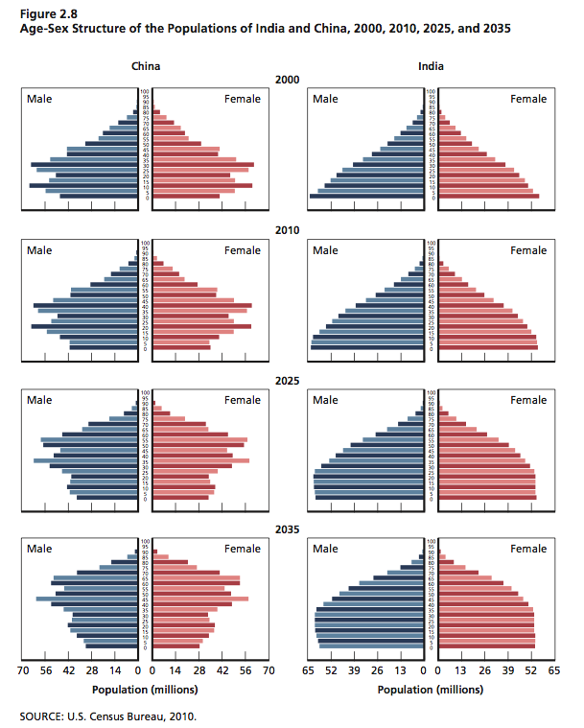
CHINA VS INDIA: AGE & POPULATION STRUCTURE 2000-35

Slide 10
ETHNIC ISSUES
Multi-ethnic country.
Currently 56 ethnic gps
91.6% are Hans, conc in the river valleys and Northern plains
55 x different ethnicities comprise bal 8.4%
18 gps have populations over one million
17 gps number between one lakh and a million
20 gps are less than one lakh in str

Slide 11
TREATMENT OF MINORITIES IN CHINA
Most are in Yunnan, some in Guangxi Chuan.
Colorful creatures of no consequence, always singing and dancing.
Exotic restaurants.
Their reps in CPPCC.
What exactly is Han anyway?

Slide 12
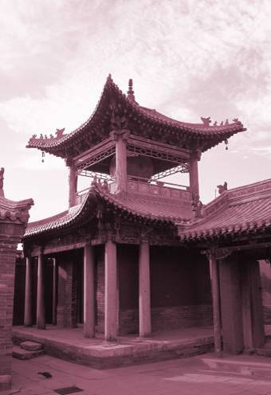
RELIGION
No Religion 74%
Buddhist 16%
Christian 2.5%
Others 7%
Muslim 0.5%

Slide 13
The government formally recognizes five religions:
Buddhism, Taoism, Catholicism, Protestantism and Islam
Chinese Catholic Church is independent of the Catholic Church in Rome).
Patriotic Church vs Underground Church.
Tibetan Buddhism.

Slide 14
EXTREMELY SUPERSTITIOUS
BEIJING OLYMPICS START TIME.
UNLUCKY NUMBERS AND LUCKY NUMBERS.
FENG SHUI.
JADE EMPEROR AND THE KITCHEN GODS.
QING MING (CLEAR BRIGHT) FESTIVAL.

Slide 15
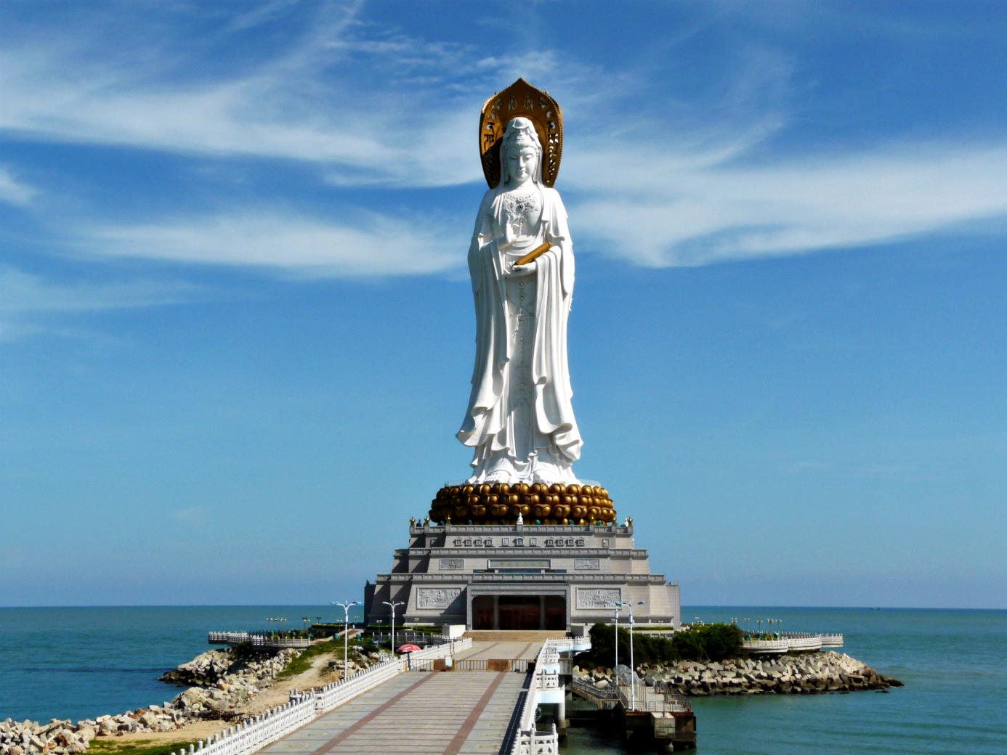

Slide 16
CONFUCIANISM
Traditional Chinese values …
Filial piety…. benevolence, “A peaceful family will prosper (jiahe wanshi xing, 家和万事兴)”
Loyalty.
Harmony…. Managing conflict.
Eight Values- Filial Piety, Sibling Harmony, Dedication, Trustworthiness, Propriety, Sacrifice, Honour, and Sense of Shame

Slide 17
Righteousness, “The gentleman understands what is moral; the small man understands what is profitable (junzi yu yu yi, xiaoren yu yu li, 君子喻于义，小人喻于利).” There are not only individual benefits but also collective and social benefits. All people should seek what benefits both the individual and the society.
Courtesy.(Modesty and prudence, respecting laws)
Wisdom.
Honesty.

Slide 18
IN BROAD
HARMONY BASED ON RELATIONSHIP BETWEEN SUPERIOR AND SUBORDINATE.
MORAL BEHAVIOUR IS THE SOURCE OF AUTHORITY OF THE SUPERIOR.
“ WELFARE OF SUBORDINATE” NOT “ RIGHTS OF SUBORDINATE”.

Slide 19
社会信用体系 (Shèhuì xìnyòng tǐxì) “Social Credit system.”
Social Engineering Experiment.
To evaluate the behaviour of Individuals and Organizations.
Massive Surveillance exercise and collection of Data.
Data analysed by Computers.
Finally award a Rating.
Affects everything, jobs, loans, school admissions, health care
Built on Cuture of Dangan (archives).
Unlike other countries no tools with the individual.

Slide 20
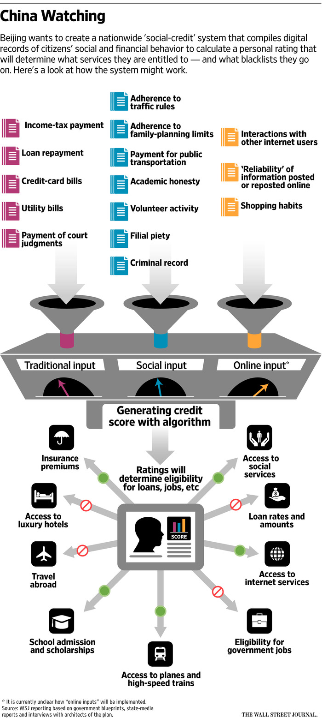

Slide 21
ONE CHILD POLICY
Little Emperors
Wo Pa Shi Ligang.
Cost of getting married.
Survey of Bethrothal gifts ($10- 20,000)

Slide 22
Li Ziqi, the Chinese internet celebrity with 58 million fans

Slide 23
Li Ziqi Channel
Li grew up with her grandparents in a rural part of Sichuan province in southwestern China. She says she moved in with them after her stepmother mistreated her.
When she was 14, she went to the city in search of work, but she decided to return to the countryside in 2012 to take care of her grandmother.
A typical Migrant worker’s life
She makes beautiful Rural based videos

Slide 24
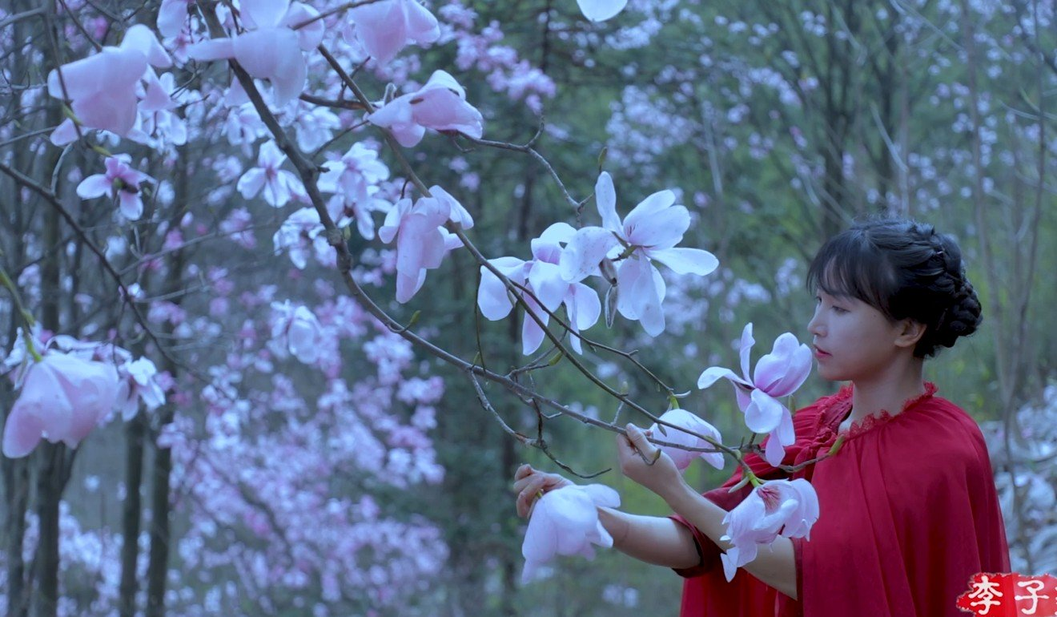
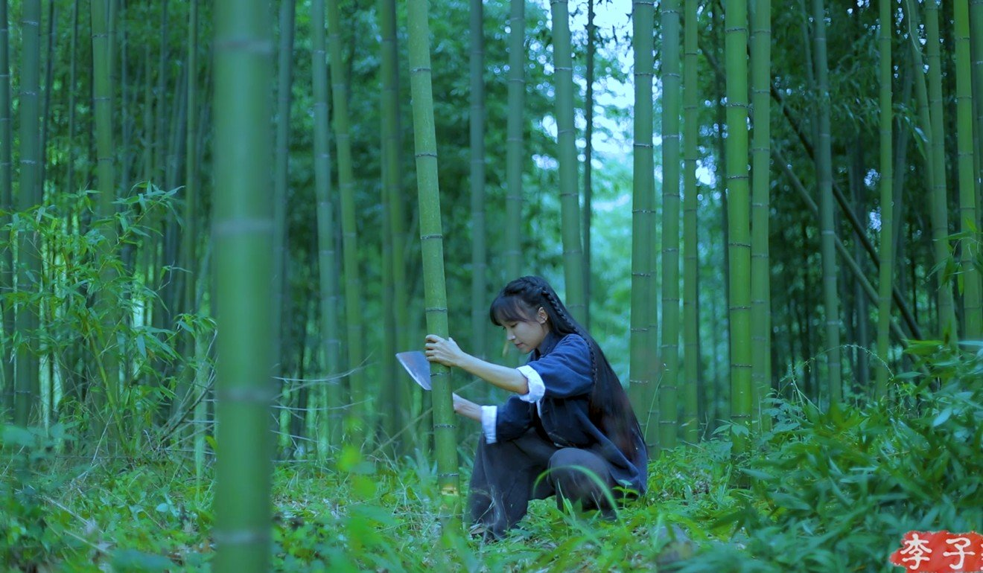
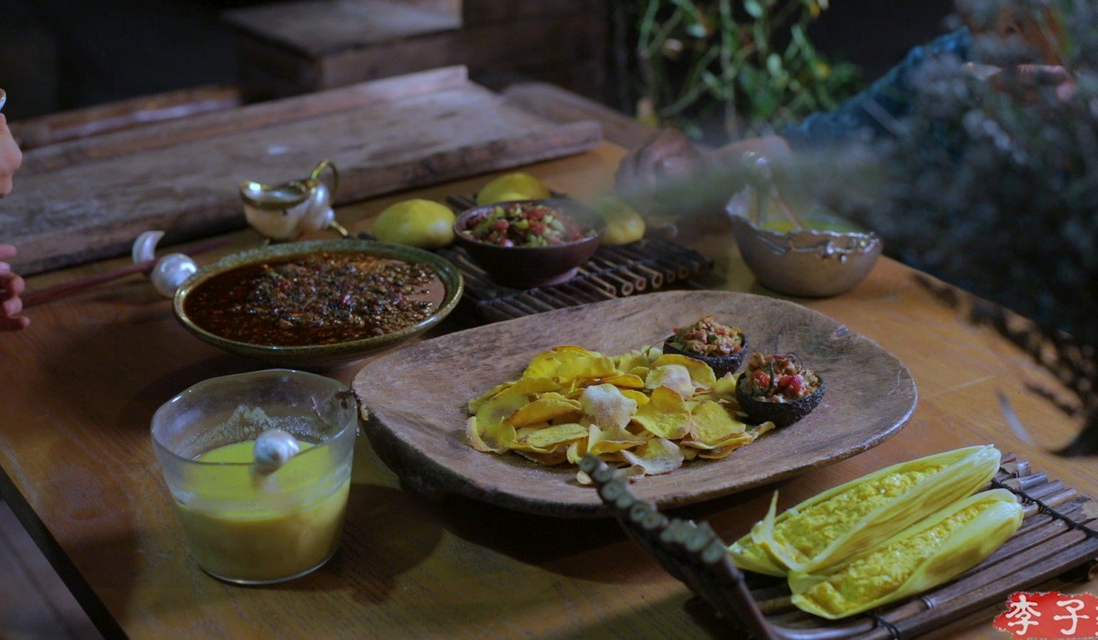
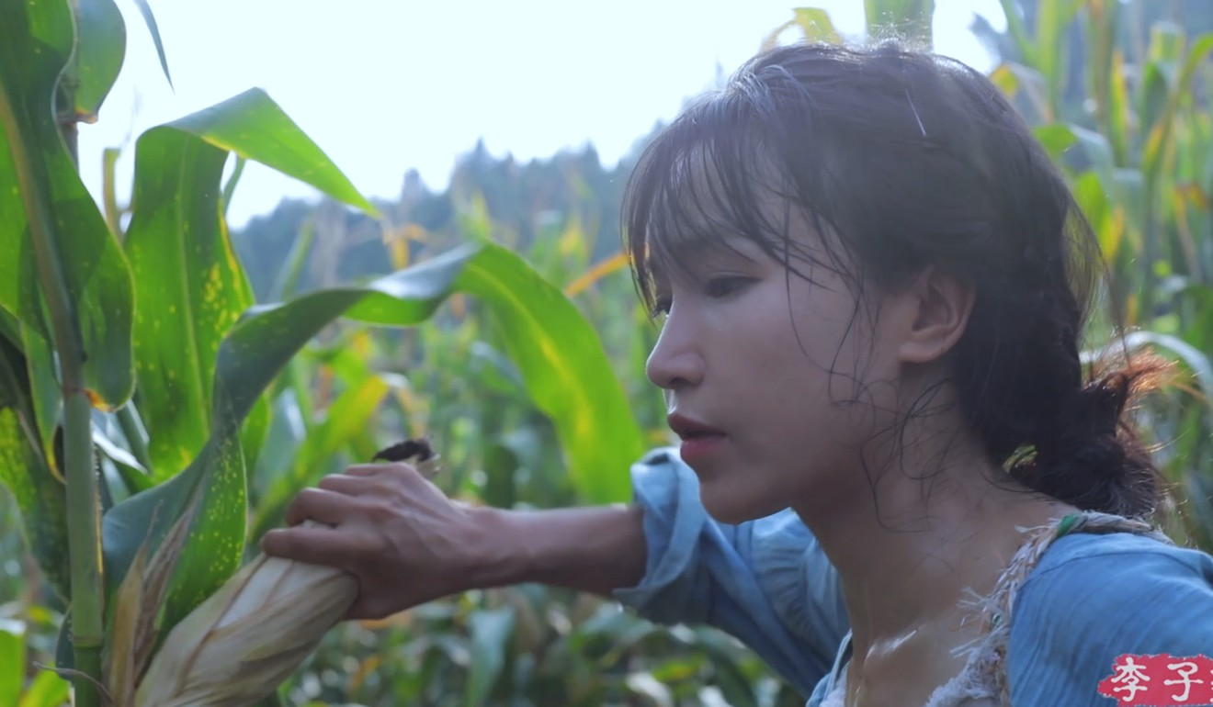

Slide 25
While the videos have a cinematic quality to them, it’s her deep knowledge of food, nature, and Chinese culture that impresses viewers. She appears to make everything from scratch, going as far as hatching baby ducklings and raising them just to make a sauce from egg yolk.
Completely Non political. Yearning for return to roots.

Slide 26
CULTURE OF SANG
Sang". That's the recent buzzword more and more young Chinese are using to describe themselves.
Pronounced "sung", this Chinese word means "mourning", and is now the trending word to reflect the reduced work ethic, a lack of self-motivation, and an apathetic demeanor felt by urban, middle-class Chinese young people.
Popular internet memes such as the soulless troll "Pepe the Frog" and the self-loathing BoJack Horseman from the titular American TV show have become the mascots of China's "sang-culture".

Slide 27

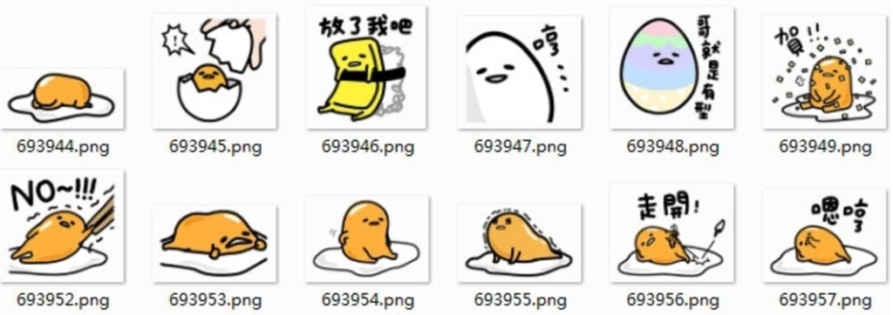
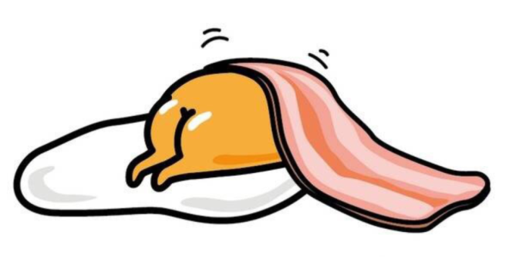
EMOJI: GUDETAMA

Slide 28
These are some of the challenges that the young of China are facing: Rising housing prices, delayed retirement, the deterioration of urban living environments, and the increasing burden of an only child taking care of two parents.
These pressures may not be concerned by every youth, but the main points were widely spread online and instilled in young generation and ultimately showed up in young people's social network.
The "sang"-culture paints youths as unwilling to succeed, but perhaps on the contrary, they identify as "sang" because of the futility in pursing traditional notions of success in their career and family.
"I admit I'm useless. How can you judge my life?"

Slide 29
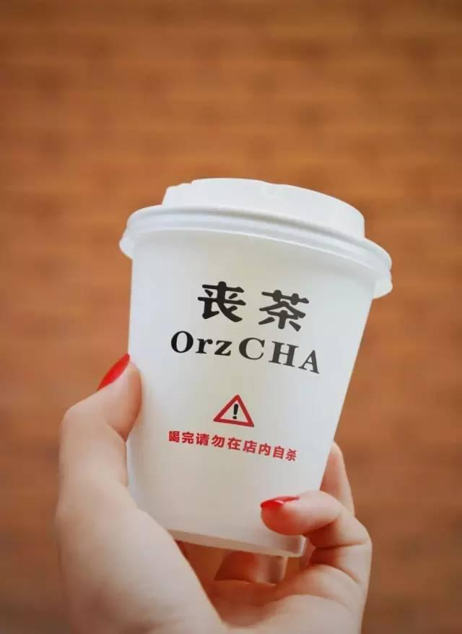
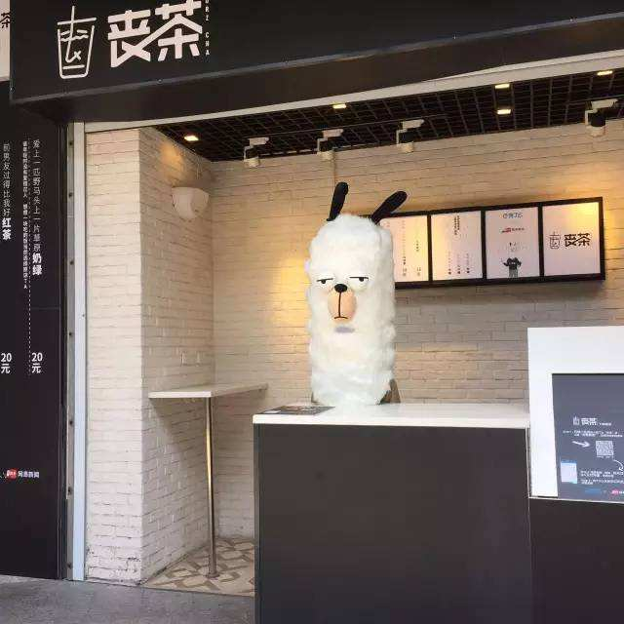
OPPORTUNISTIC
"Do not kill yourself inside our store after finishing your drink", says the cup.
Some of the drinks on the menu are named such as "Wasting-life Green Tea", "Failed-another-diet Latte", and "Can't-afford-to-buy-house Macchiato".

Slide 30
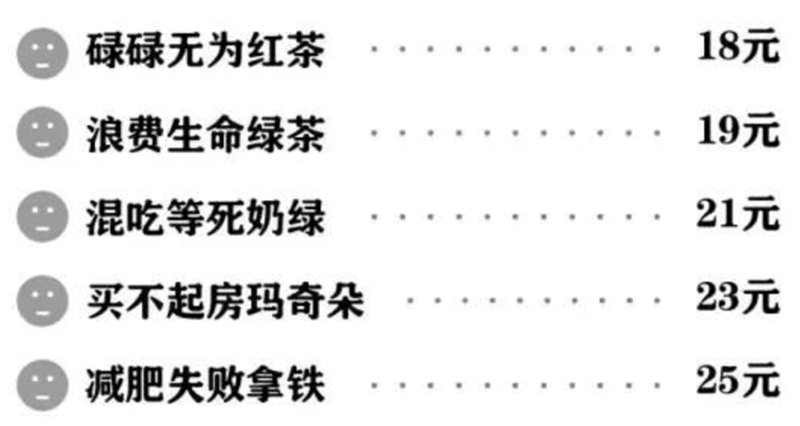
"Wasting-life Green Tea",
"Failed-another-diet Latte“
"Can't-afford-to-buy-house Macchiato".
“achieved-absolutely-nothing black tea,”
“my-ex’s-life-is-better-than-mine fruit tea.”

Slide 31
RENT A GIRLFRIEND
Or Boy Friend

Slide 32
Sheng Nu: LEFTOVER WOMEN
Globally 107:103 vs 120: 100
The Term,,,,,No Longer Negative….. But successful.
"There is an opinion that A-quality guys will find B-quality women, B-quality guys will find C-quality women, and C-quality men will find D-quality women, The people left are A-quality women and D-quality men. So if you are a leftover woman, you are A-quality."
Similarly Sheng nan and Guang Gun (bare branches)

Slide 33
P2P LENDING
The Jiedaibao case.
30% Interest Rates

Slide 34
笑贫不笑娼
Xiào pín bù xiào chāng
(Despise poverty not prostitution)

Slide 35
THANK YOU

